Slide 1
COMPUTER BASICS

Slide 2
Goals and Objectives
Be introduced to basic components of the computer
Learn common computer terms
Become familiar with basic computer hardware and software
Become familiar with the computer mouse and keyboard
Learn about the desktop

Slide 3
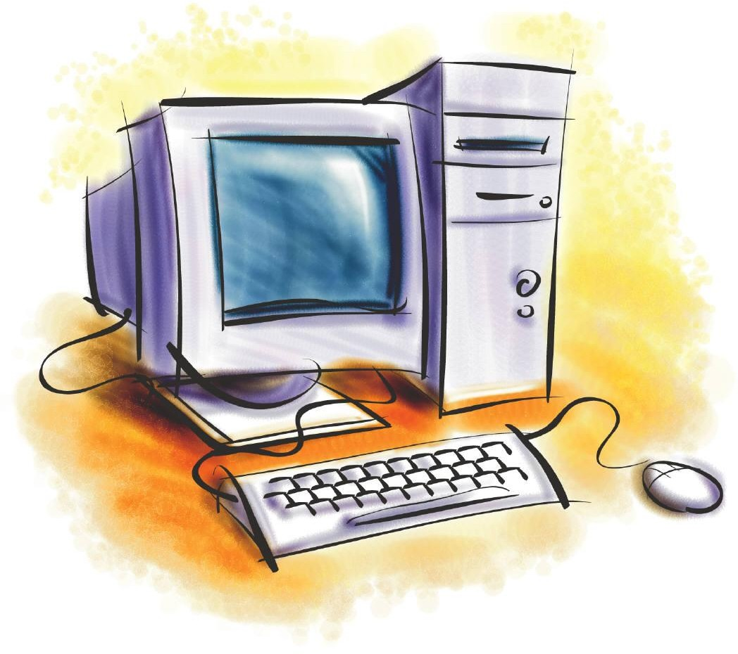
Introducing the Computer

Slide 4
What is a Computer?
An electronic device that accepts input, processes data, provides storage and retrieval and provides output for the user.
You can use a computer to type documents, send email, browse the internet, handle spreadsheets, do presentations, play games, and more.

Slide 5
Hardware/Software
A computer is made up of only two components: hardware and software. Anything you buy for your computer can be classified as either hardware or software.
Hardware: is any part of your computer that has a physical structure. If you can touch it, it is hardware.
Software: the brains of the computer, is any set of instructions that tells the hardware what to do and helps the user accomplish a certain task

Slide 6
Hardware
Hardware consists of two components, input and
output devices.
Input Device
An input device allows us to put information into the computer.
Examples include: Mouse, keyboard, microphone, flash drive or scanner
Output Devices
An output device displays (or puts out) information from a computer in either a visual or auditory format.
Examples include: Monitor, Speakers, headphones or printer

Slide 7
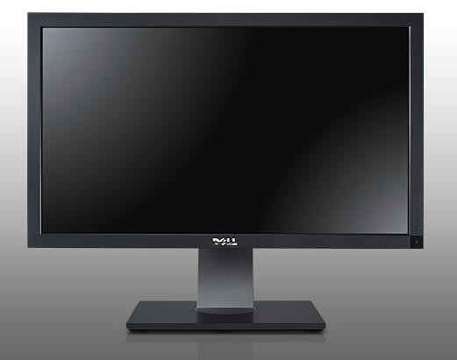
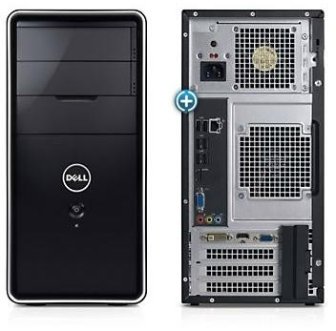
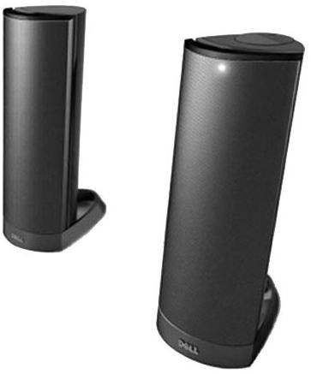
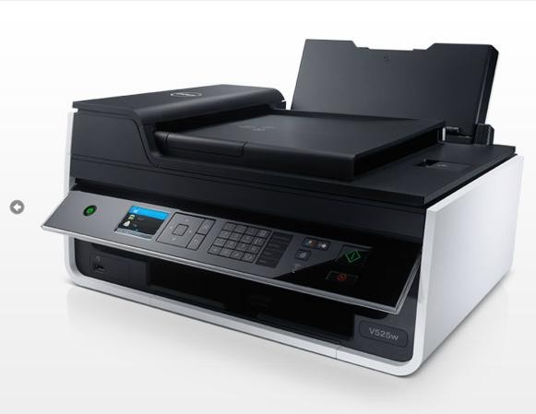
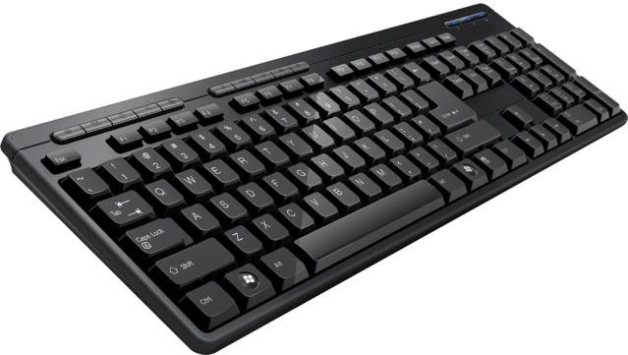
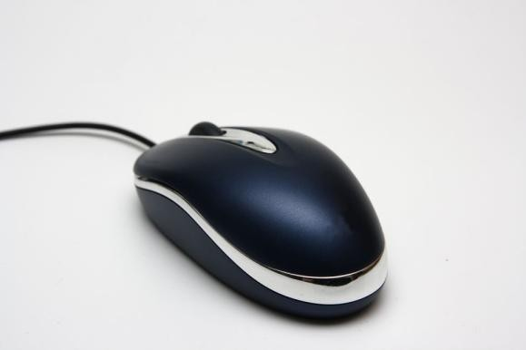
Basic Computer Equipment
Monitor
Speakers
Console
Printer
Keyboard
Mouse

Slide 8
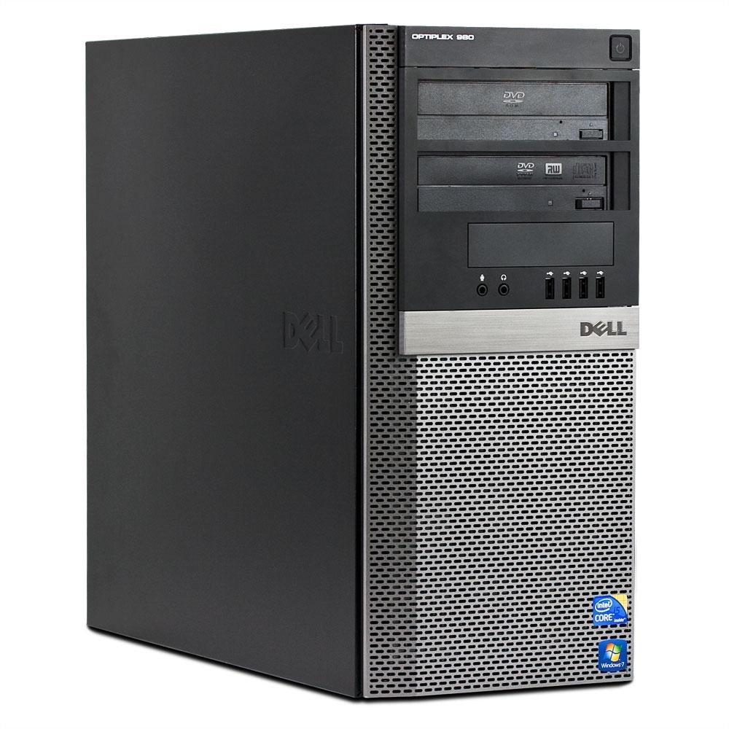
Console
Console: The console, or system unit, is the heart of your computer. It houses many electronic components, serves as the main connecting point for other devices, and shields all of the vital working parts of your PC, from dust, dirt, static electricity, etc.
by Shonda Hodge

Slide 9
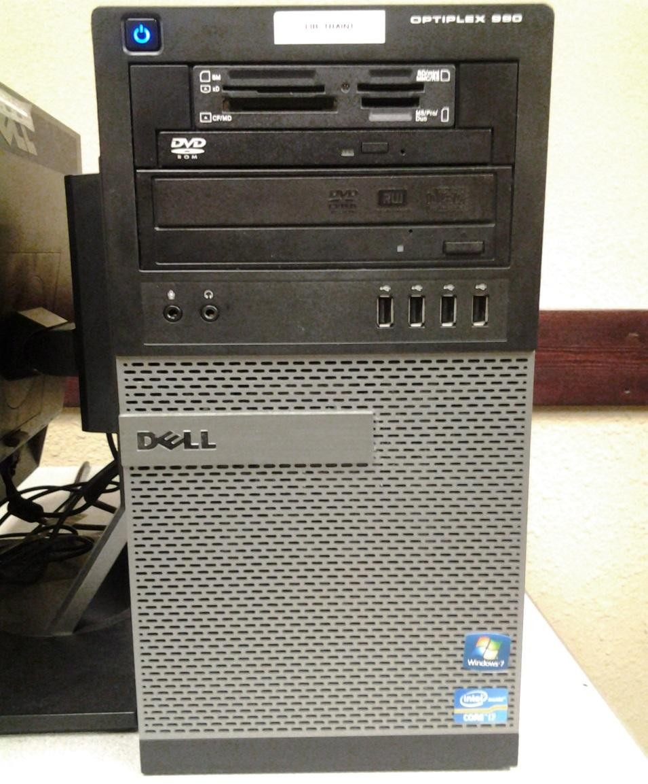
Console
Power Button
SD Card Port
CD/DVD Drive (Play ony)
CD/DVD Drive (Play/Write)
Microphone Port
USB Ports
Headphones Port

Slide 10
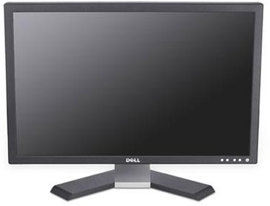
Monitor
Monitor: displays the text and graphic information generated by the console

Slide 11
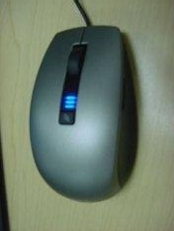
Mouse
Mouse: pointing device that allows you to select and manipulate objects you see on your monitor.
Left Click - used to select or place cursor where you want it on the page
Double Click - used to open a program
Drag and Drop - used to pick up and move a picture or object to another area
Click and drag - used to select multiple items or highlight text
Right Click - gives a drop down menu of options specific to the task you’re trying to perform
To practice using a mouse, go to: pbclibrary.org/mousing/

Slide 12
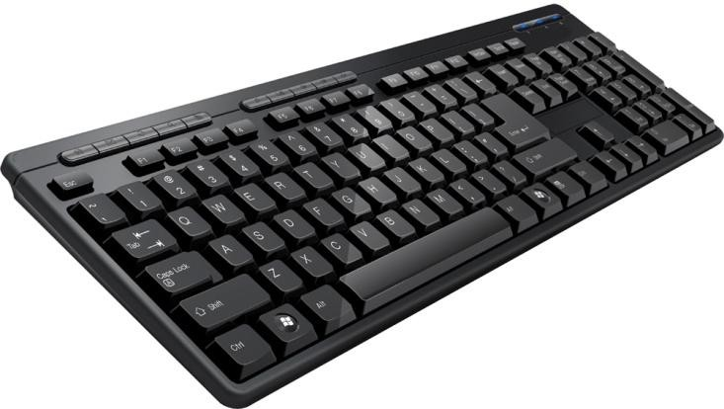
Keyboard
Keyboard: The keyboard allows you to enter letters, numbers, symbols, and other commands into your computer.
Keyboards and Mice are universal meaning that any kind can be plugged into a computer and will work. QWERTY refers to the standard US keyboard and refers to the first six letters on the keyboard.

Slide 13
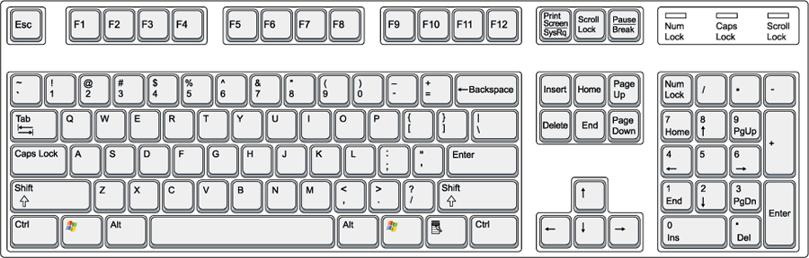
Keyboard Buttons
Tab – used to indent paragraphs by moving your cursor over ten spaces or to move from field to field in a form
Caps Lock – makes all letters capital until you turn it off
Shift - allows you to capitalize letters when pressed down and allows you to access the secondary function of your computer keys
Space Bar – adds one blank space between objects
Windows Key – open and closes
your windows start menu
Enter – starts a new line or functions as the “Go” key when navigating to a website, opening a program, etc.
By Angie Moore

Slide 14

Keyboard Buttons
Backspace – erases the object to the
left of the cursor
Delete – erases the object to the right of the cursor
Home – moves your cursor to the
front of your line of text
End – moves your cursor to the
end of your line of text
Insert – allows you to replace a word with another by writing over it
www.typingweb.com www.keybr.com
By Angela Moore

Slide 15
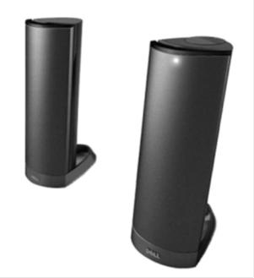
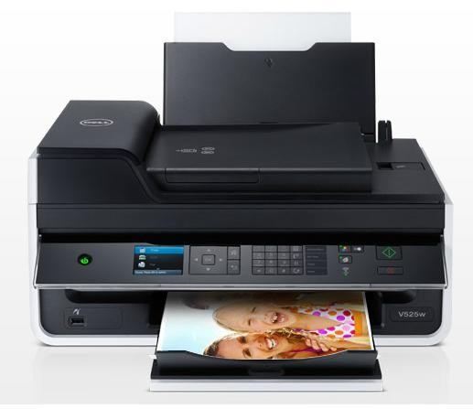
Printers/Speakers
Printer: device that reproduces text and pictures that you create on paper
Inkjet Printer:
Most popular, least expensive
Occasional printing (Home use)
Uses print cartridges
Decent quality image
Laser Printer
More expensive
Extensive Printing (Office use)
Uses toner cartridges
Higher quality image
Speakers: sound card in computer pushes sound out through the speakers

Slide 16
Review
What are the two main components of all computers?
What two components does hardware consist of?
Give me one example of an input device and one example of an output device
What 5 clicks did we learn for the mouse function?

Slide 17
Software
Software is any set of instructions that tells the hardware what to do. It is what guides the hardware and tells it how to accomplish each task.
Some examples of software are web browsers, games, and word processors such as Microsoft Word.

Slide 18

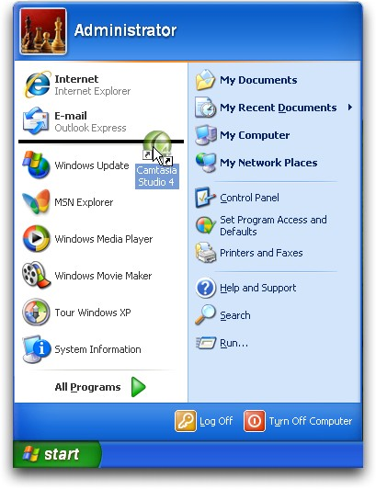
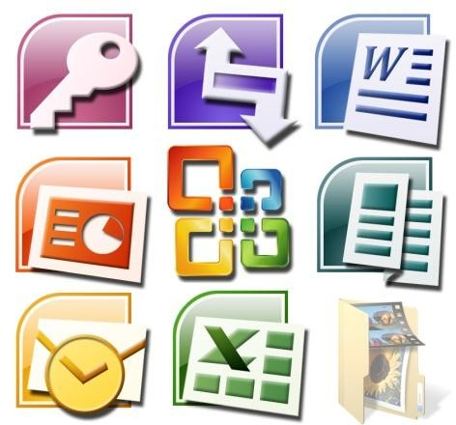
Examples of Software
Browsers
Internet Explorer
Mozilla Firefox
Google Chrome
Games
Solitaire
Office
Word
Excel
PowerPoint
All programs
Anything listed under all programs and anything you download

Slide 19
Windows Operating System Overview
Types: 97, XP, Vista, 7, 8/8.1
The PC’s brain or Master Software
Primary duty is to control the computer, all the hardware.
Secondary duty is to control all the software, basically running the programs and managing the files and documents you create.
Third duty is to interact with you.

Slide 20
Review
Is the keyboard an input or output device?
What does the shift button allow you to do?
What is the difference between backspace and delete?
What are two examples of software?

Slide 21
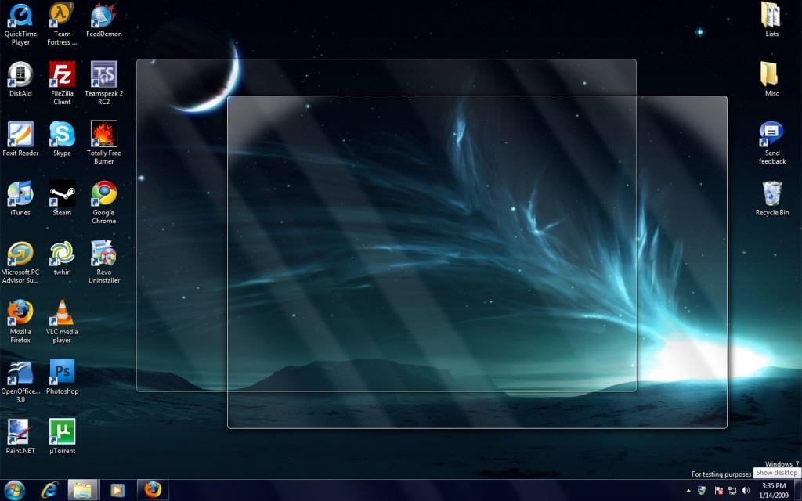
Meet your Desktop

Slide 22
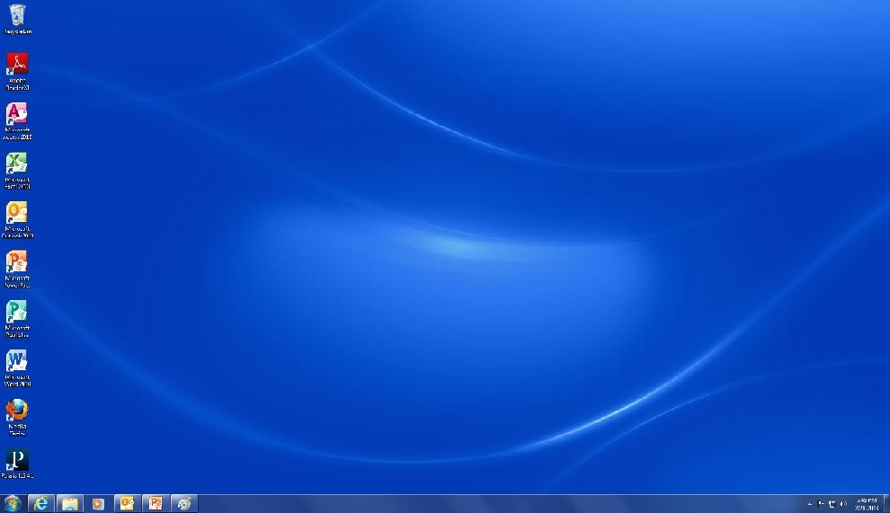
Desktop
Icons
Quick Launch Bar
System Tray
Task Bar
Start button
By Angie Moore

Slide 23
Desktop
The place where you can easily gain access to everything on your computer
Uses icons to represent programs on your computer.
Background on which the icons sit is called the ‘desktop’.
Use the mouse to move around on the desktop

Slide 24
Icons
Icons represent programs you have on your computer
They act as shortcuts to your programs and are instantly accessible from your desktop instead of having to go to the start menu and open them.
Icons are movable and can be arranged any way you want.
Any program or file on your computer can be an icon including
pictures, documents, and other software.
You can create icons one of two ways:
1) Go to the start menu and right click on a program. Select send to.
Select desktop and a copy of it will now be on your desktop
2) Go to your libraries folder and right click on a document, music file, or picture file. Select send to. Select desktop and a copy of it will now be on your desktop
Note: Double click icons to open them

Slide 25
Taskbar
Blue strip along the bottom of the desktop.
Serves as the Windows control center.
Three important items on the taskbar: Start menu, Quick Launch Bar, System tray

Slide 26
Taskbar
Start Menu: contains all programs on your computer. Programs are listed in alphabetical order. Items that you use frequently can be pinned to the start menu.
Quick Launch Bar: contains programs that are pinned to the taskbar and can be accessed simply by clicking the program. Items that you use frequently can be pinned to the quick launch bar.
Note: Start menu and quick launch bar items only need to be
clicked once to open them
System Tray contains your general computer information such as time, date, sound volume, power supply, the usb icon when one is plugged in, security antivirus information, updates for your computer, internet connection, and computer processes.

Slide 27
Personalization
When you right click on your desktop, you get a series of options that you can use to make it look how you want it to look
View: allows you to change the size of your icons, arrange them in the order you want and choose to hide them or show them
Sort By: allows you to sort your icons by name, size, item type or date modified
New: allows you to create a new folder or document and places it directly on your desktop
Personalize: allows you to change the background on your desktop, your screensaver settings, your color scheme, your mouse pointer and other cosmetic changes

Slide 28
Review
What on the desktop do you have to double click to open?
What three items are located on the taskbar?
What’s one place you can pin items you use frequently?
What is the system tray used for?

